Slide 1
ASSESSING STUDENT LEARNING
By: Jason Baillargeon
Norwich Free Academy

Slide 2
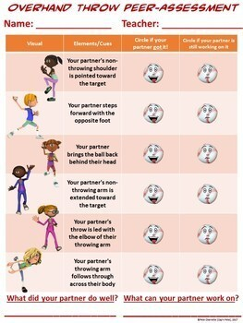
ASSESSMENT HUNT: PSYCHOMOTOR
Psychomotor Peer-Assessment allows students to engage with each other while thinking about cues and what the partner is doing well or can do better with. This assessment provides an honest opinion from somebody other than the teacher.

Slide 3
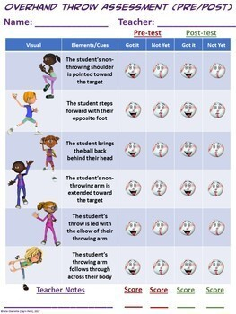
ASSESSMENT HUNT: PSYCHOMOTOR
Psychomotor checklist allows the teacher to observe students throughout the lesson and grade them based on observed results.

Slide 4
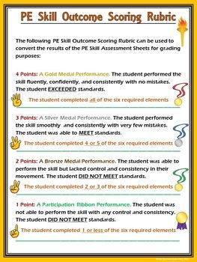
ASSESSMENT HUNT: PSYCHOMOTOR
Psychomotor Rubric gives students a baseline of expectations for what they need to be able to do throughout the class and what score they would receive accordingly.

Slide 5
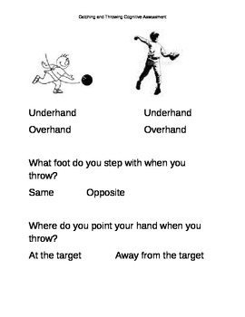
ASSESSMENT HUNT: COGNITIVE
Cognitive Exit slip allows written proof of student learning at the conclusion of each lesson, teacher can grade them and bring them back for the next lesson.

Slide 6
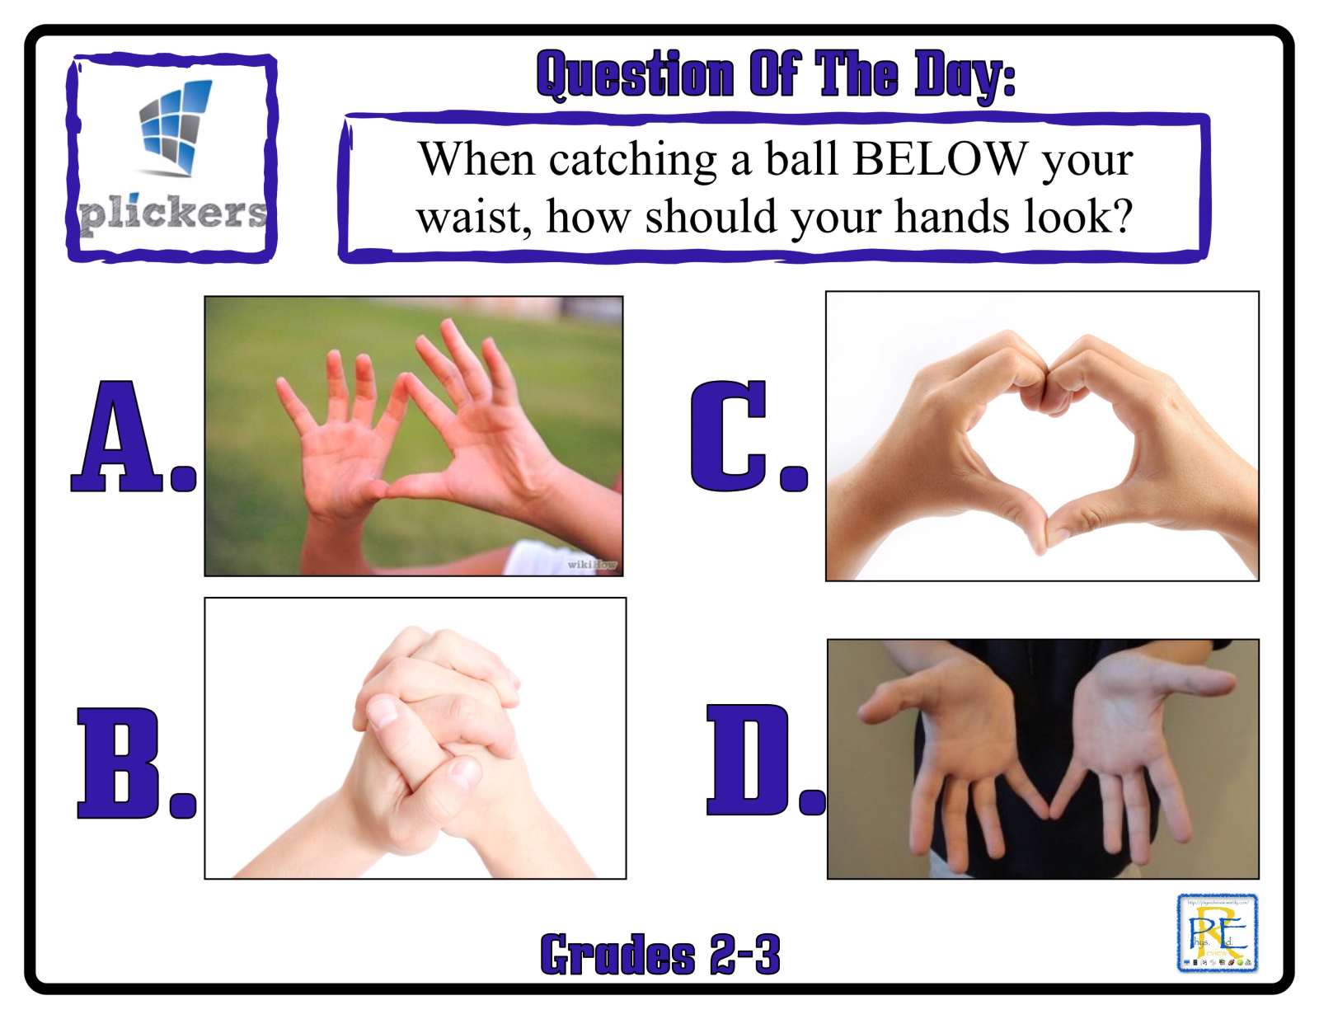
ASSESSMENT HUNT: COGNITIVE
Cognitive Quiz checks for understanding that students are grasping the content as intended.

Slide 7
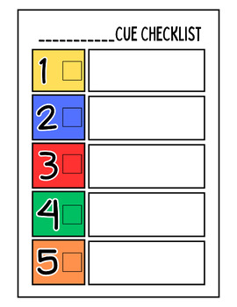
ASSESSMENT HUNT: COGNITIVE
Cue Checklist is a cognitive check for understanding that the students know what steps they must take to find success in performing the skill.

Slide 8
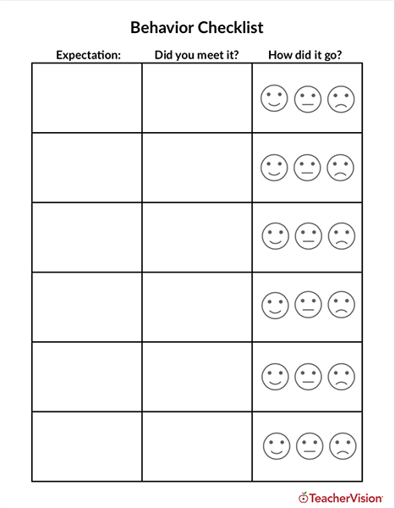
ASSESSMENT HUNT: AFFECTIVE
Behavioral Checklist assesses affective domain throughout the lesson and allows the teacher to give students what expectations are required to earn a happy face.

Slide 9
ASSESSMENTS CHOSEN
This unit will be assessed in the psychomotor domain by using teacher checklists, and additionally in the cognitive domain using exit slips looking for cues and other questions relevant to the specific lesson and unit.

Slide 10
IMPLEMENTATION OF ASSESSMENT
NAME | SHOULDER TOWARD TARGET | RIP CHEST TO CHEST | RELEASE
STUDENT 1 | Yes | Yes | Yes
STUDENT 2 | Yes | Yes | Yes
STUDENT 3 | Yes | No | Yes
STUDENT 4 | Yes | Yes | Yes
STUDENT 5 | Yes | Yes | Yes
STUDENT 6 | Yes | Yes | Yes
STUDENT 7 | Yes | Yes | Yes
STUDENT 8 | Yes | Yes | Yes
STUDENT 9 | Yes | No | Yes
STUDENT 10 | Yes | Yes | Yes
STUDENT 11 | No | Yes | Yes
STUDENT 12 | Yes | Yes | Yes
STUDENT 13 | No | Yes | Yes
STUDENT 14 | Yes | Yes | Yes
STUDENT 15 | Yes | No | Yes
STUDENT 16 | Yes | Yes | Yes
STUDENT 17 | Yes | Yes | Yes
STUDENT 18 | No | Yes | Yes
STUDENT 19 | Yes | Yes | Yes
STUDENT 20 | Yes | No | Yes
STUDENT 21 | Yes | Yes | Yes
STUDENT 22 | Yes | Yes | Yes
STUDENT 23 | Yes | Yes | Yes
STUDENT 24 | Yes | Yes | Yes
Backhand Grip Post-Assessment
Students will be assessed in the psychomotor domain by the teacher moving around station to station or observing a whole class activity watching for specific skills or objectives dependent on the objective. This example is data taken from the Pre-Assessment of Backhand Grip.

Slide 11
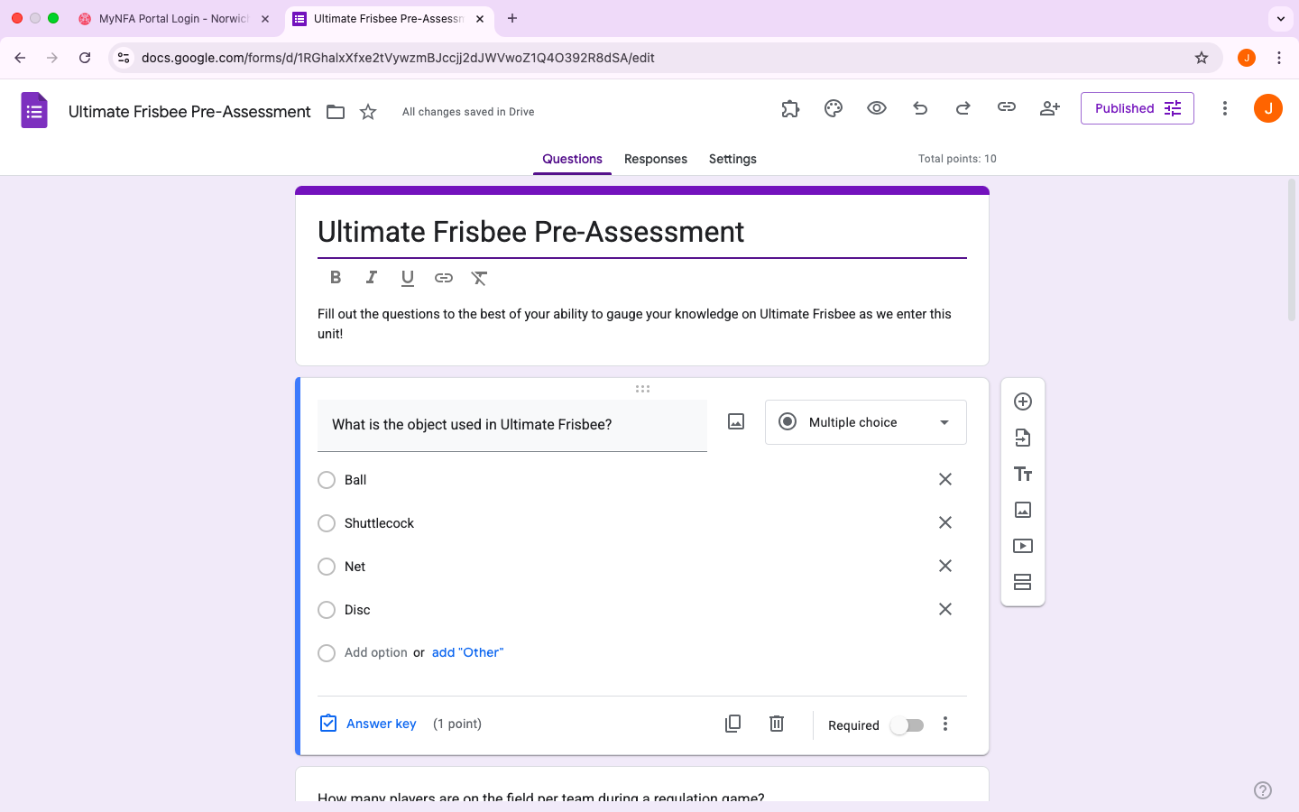
IMPLEMENTATION OF ASSESSMENT
The cognitive domain will also be assessed using exit slips and pre and post assessments of the knowledge of rules and regulations of Ultimate Frisbee

Slide 12
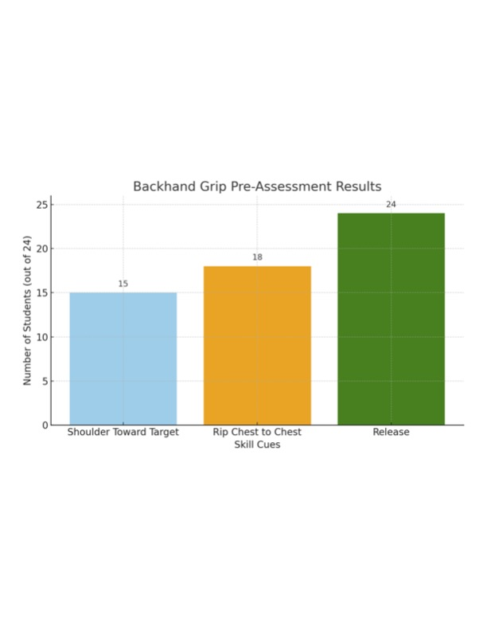
ANALYSIS OF BEGINNING DATA

Slide 13
ANALYSIS OF BEGINNING DATA
This data is taken from the Pre-Assessment of this unit and shows that majority of the students in the class found themselves not reaching the success rate targeted for the end of this unit. This leaves a lot of room for improvement over the course of the unit the psychomotor domain. The teacher assessed this data taking time with each student station by station documenting what the student was presenting.

Slide 14
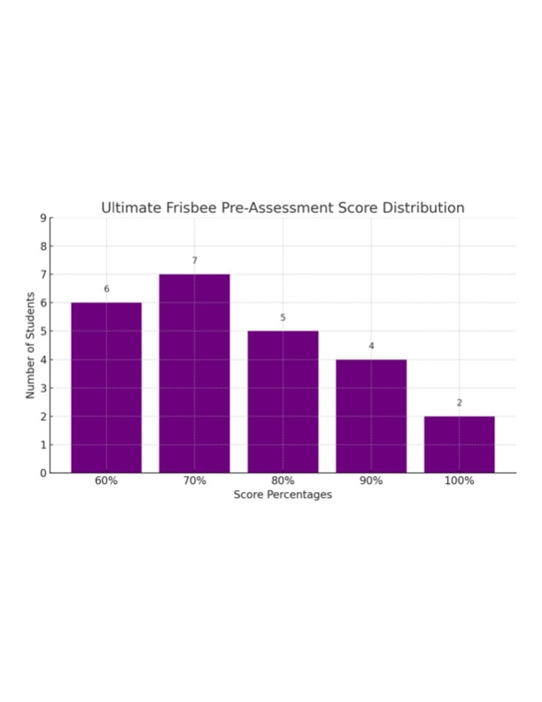
ANALYSIS OF BEGINNING DATA

Slide 15
ANALYSIS OF BEGINNING DATA
This Pre-Assessment shows that a good portion of the class is unfamiliar with the game of Ultimate Frisbee and that going forward it will be a large focus throughout the course of this unit..

Slide 16
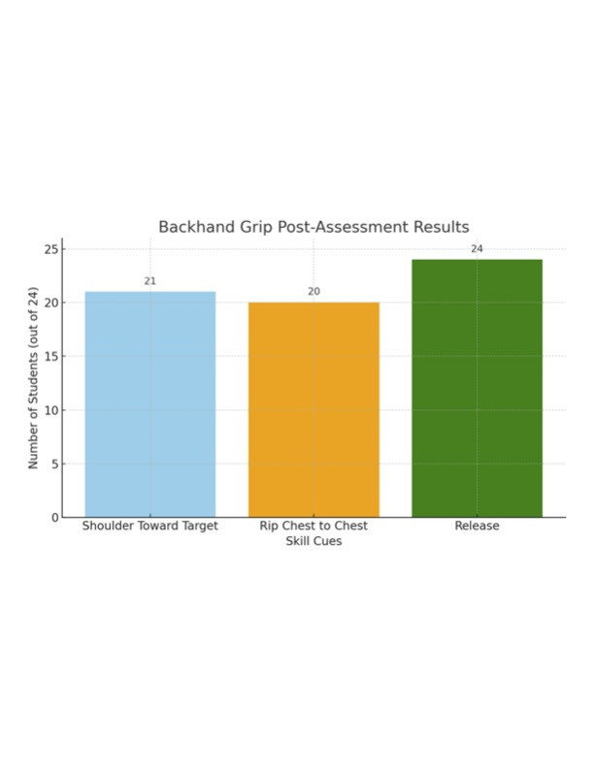
ANALYSIS OF FINAL DATA

Slide 17
ANALYSIS OF FINAL DATA
This graph shows that a major improvement was shown over the course of this unit in the Psychomotor Domain. There was major improvement shown in following the cues of shoulder pointed towards the target as well as rip the disc from chest to chest.

Slide 18
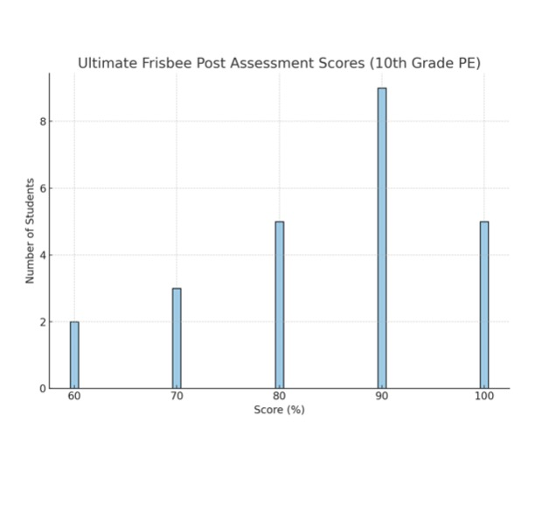
ANALYSIS OF FINAL DATA
Cognitively, I was very happy to see the class improve from thirteen students scoring 70 or below on the Ultimate Frisbee Pre-Assessment to only five students fitting into this range on the post-assessment.

Slide 19
CONCERNS OF VALIDITY
Any concerns of validity should be put at ease due to the number of assessments given out over the course of this unit, and the amount of footage taken of myself giving corrective feedback to students, emphasizing the goals of all lessons, and myself maneuvering throughout the entire space during every lesson. Students were always given multiple chances before getting score on the checklist. Cognitively, I have every students exit slip graded and feedback given on the final assessment to focus students.

Slide 20
REFLECTION FOR FUTURE ASSESSMENTS
This experience with assessment has been incredibly valuable for my growth as a teacher. In talking with my cooperating teacher, I have concluded that using Google Classroom for conducting assessments is the most effective way to go with this age group. This particular group of students would be very against any kind of pen and paper assessments.

Slide 21
ASSESSMENT COMMENTARY
IThe feedback given to these three focus students are all vastly different from another. I must constantly challenge my higher-level focus student due to her athletic background and consistent willingness to go all out while in PE Class. My medium level student is hit or miss with their dedication to the lesson, and I often must encourage them to stick with the process of our unit progression. My lower-level student is not a fan of PE class, but it has been extremely rewarding being able to motivate that student and seeing them begin to express more interest in full group activity

Slide 22
ASSESSMENT COMMENTARY
I will support each focus student in whatever way they need me to and I will make sure as a Physical Educator that my teachings have differentiated learning geared differently towards all three of the focus students. I made sure throughout this unit that I would pull these three specifically aside and check in with them with positive feedback that they are showing me everything I want to see from them.]

