Slide 1
ASSESSING STUDENT LEARNING
By: Jason Baillargeon
Norwich Free Academy

Slide 2
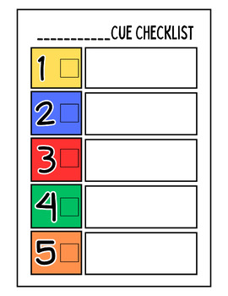
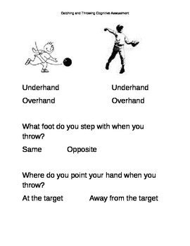
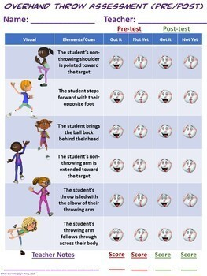
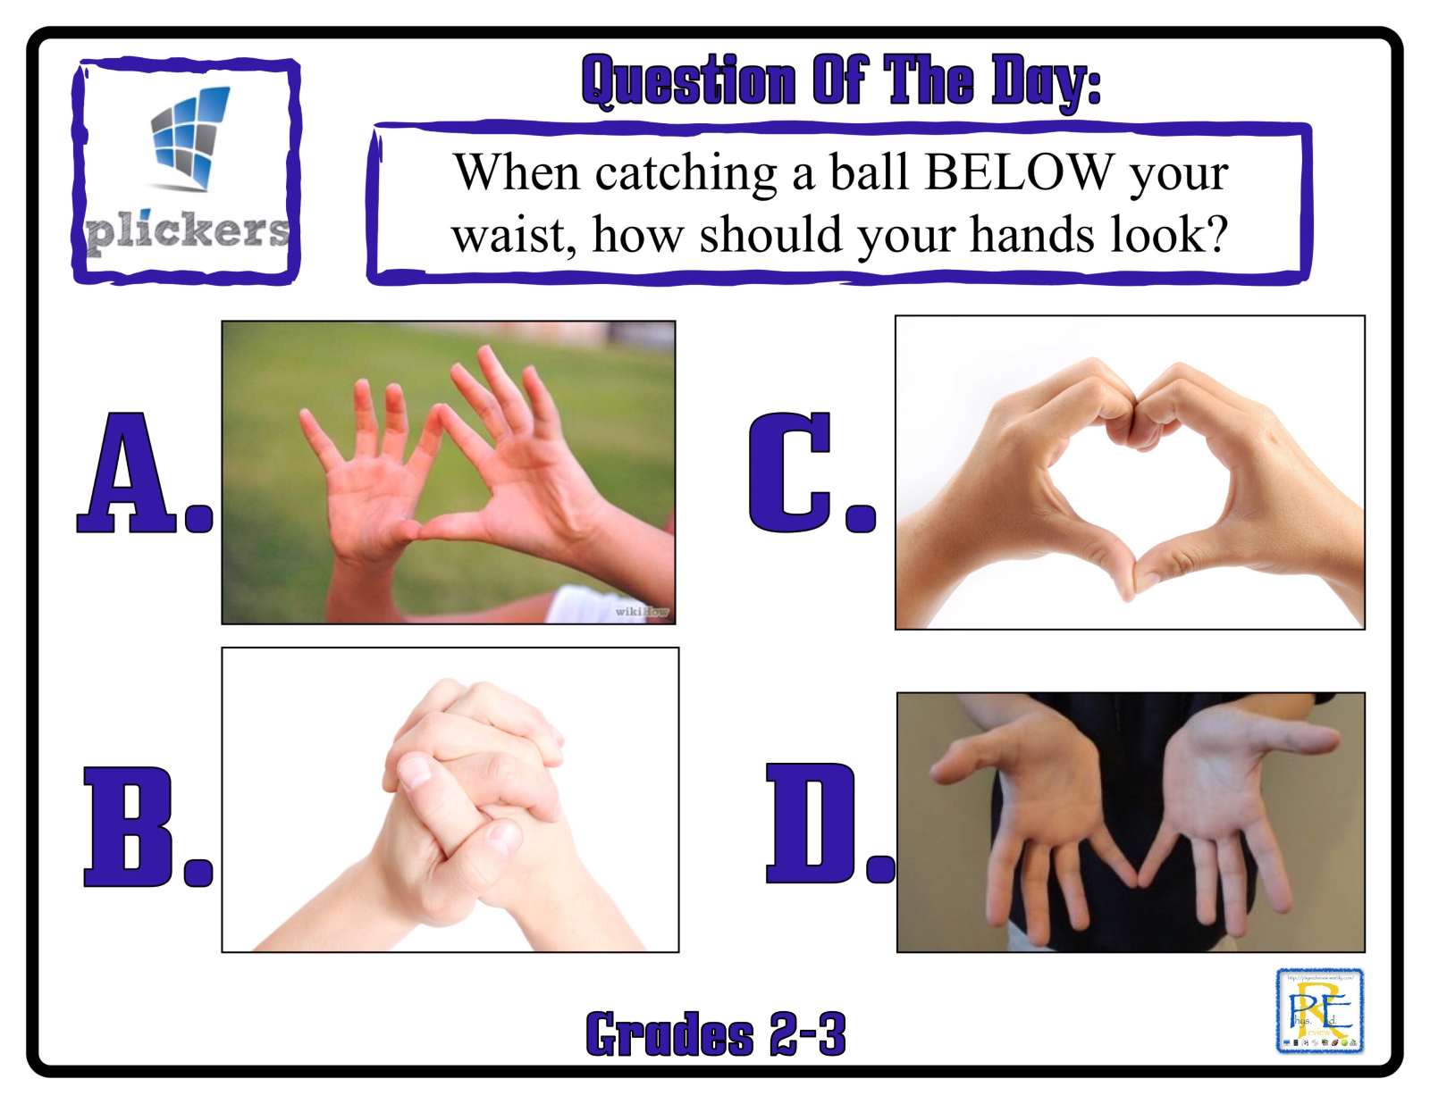
ASSESSMENTS CHOSEN
This unit will be assessed in the psychomotor domain by using teacher checklists, and additionally in the cognitive domain using exit slips looking for cues and other questions relevant to the specific lesson and unit.

Slide 3
IMPLEMENTATION OF ASSESSMENT
NAME | SHOULDER TOWARD TARGET | RIP CHEST TO CHEST | RELEASE
STUDENT 1 | Yes | Yes | Yes
STUDENT 2 | Yes | Yes | Yes
STUDENT 3 | Yes | No | Yes
STUDENT 4 | Yes | Yes | Yes
STUDENT 5 | Yes | Yes | Yes
STUDENT 6 | Yes | Yes | Yes
STUDENT 7 | Yes | Yes | Yes
STUDENT 8 | Yes | Yes | Yes
STUDENT 9 | Yes | No | Yes
STUDENT 10 | Yes | Yes | Yes
STUDENT 11 | No | Yes | Yes
STUDENT 12 | Yes | Yes | Yes
STUDENT 13 | No | Yes | Yes
STUDENT 14 | Yes | Yes | Yes
STUDENT 15 | Yes | No | Yes
STUDENT 16 | Yes | Yes | Yes
STUDENT 17 | Yes | Yes | Yes
STUDENT 18 | No | Yes | Yes
STUDENT 19 | Yes | Yes | Yes
STUDENT 20 | Yes | No | Yes
STUDENT 21 | Yes | Yes | Yes
STUDENT 22 | Yes | Yes | Yes
STUDENT 23 | Yes | Yes | Yes
STUDENT 24 | Yes | Yes | Yes
Backhand Grip Post-Assessment
Students will be assessed in the psychomotor domain by the teacher moving around station to station or observing a whole class activity watching for specific skills or objectives dependent on the objective. This example is data taken from the Pre-Assessment of Backhand Grip.

Slide 4
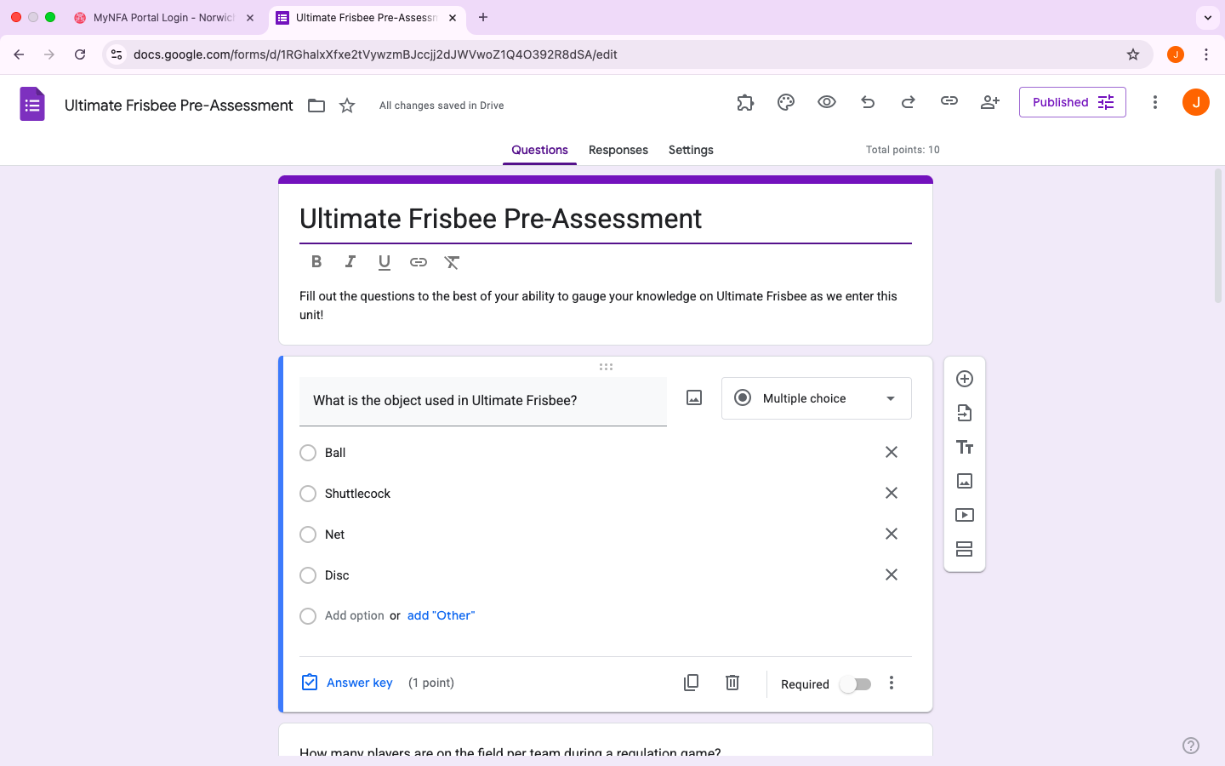
IMPLEMENTATION OF ASSESSMENT
The cognitive domain will also be assessed using exit slips and pre and post assessments of the knowledge of rules and regulations of Ultimate Frisbee

Slide 5
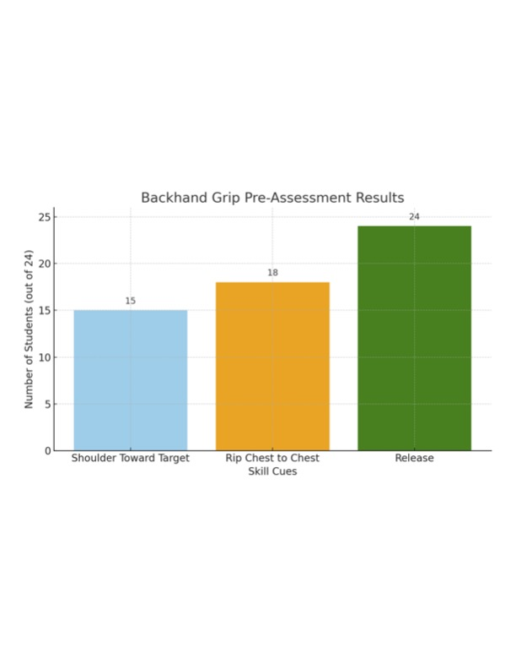
ANALYSIS OF BEGINNING DATA

Slide 6
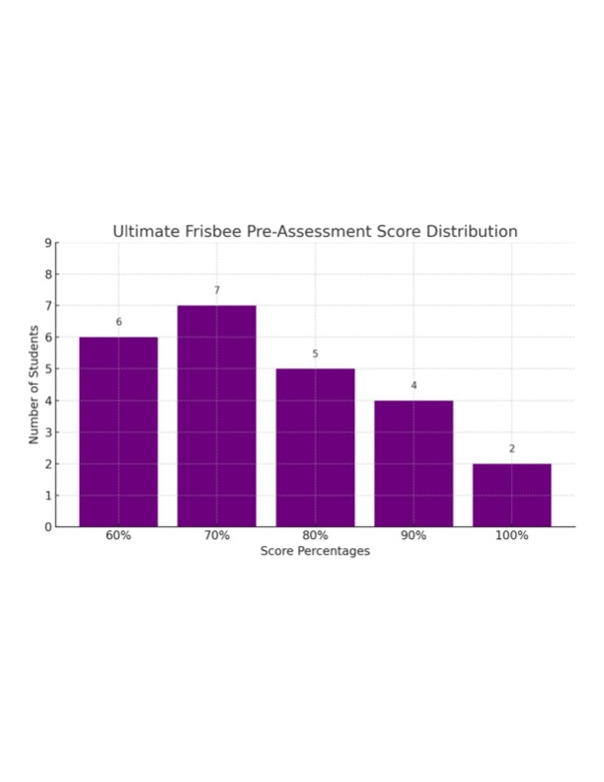
ANALYSIS OF BEGINNING DATA

Slide 7
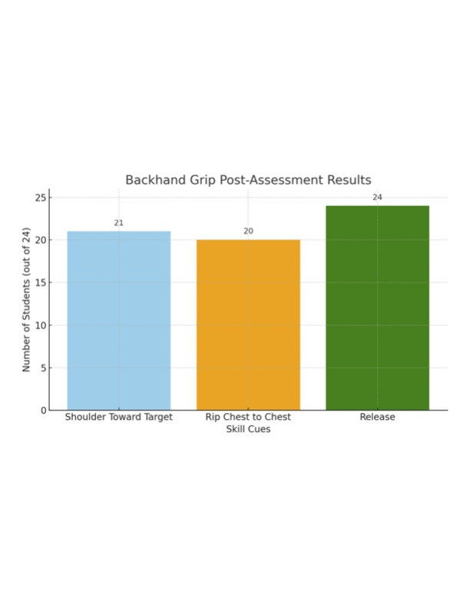
ANALYSIS OF FINAL DATA

Slide 8
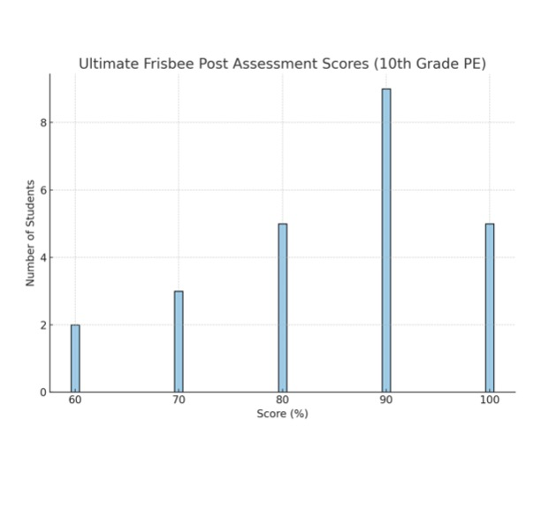
ANALYSIS OF FINAL DATA
Cognitively, I was very happy to see the class improve from thirteen students scoring 70 or below on the Ultimate Frisbee Pre-Assessment to only five students fitting into this range on the post-assessment.

Slide 9
REFLECTION FOR FUTURE ASSESSMENTS
This experience with assessment has been incredibly valuable for my growth as a teacher. In talking with my cooperating teacher, I have concluded that using Google Classroom for conducting assessments is the most effective way to go with this age group. This particular group of students would be very against any kind of pen and paper assessments.

